Slide 1
Motivation for optimal binary search tree problem
Translating text (on-line dictionary)
For each occurrence of each word in the text, we need to look up its translation
Goal: minimize total time spent searching for translation of text words

Slide 2
Solution 1: build a binary search tree
O(lg n) search time per occurrence by using a balanced binary search tree.
Drawback: Words appear with different frequencies
  frequently used word such as “the” may appears far from the root
  rarely used word appear near the root.
We want words that occur frequently in the text to be placed nearer the root.
Note: root selection affects structure

Slide 3
Optimal binary search tree
Given: Sequence K of n distinct sorted keys (k₁ < k₂ < … < k_{n}).
Probability of searching for k_{i} is p_{i}
Some searches may be for values not in K
We add n+1 “dummy keys” d₀, d₁, d₂, … ,d_{n}
  d₀ represents all values less than k₁
  d_{n} represents all values greater than k_{n}, and
  for i = 1, 2, …, n-1 d_{i} represents all values between k_{i} and k_{i+1}.
d_{i} is searched with probability q_{i}

Slide 4
Binary search tree for n=5
k₂=going
k₁=everything
k₄=my
d₀
d₁
k₅=way
k₃=is
d₂
d₃
d₄
d₅
i | 0 | 1 | 2 | 3 | 4 | 5
p_{i} |  | .15 | .1 | .05 | .1 | .2
q_{i} | .05 | .1 | .05 | .05 | .05 | .1
Text: everything is
going my way

Slide 5
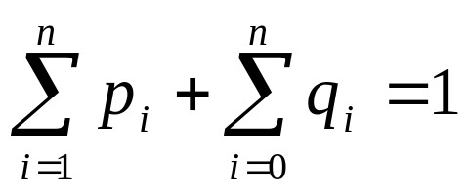
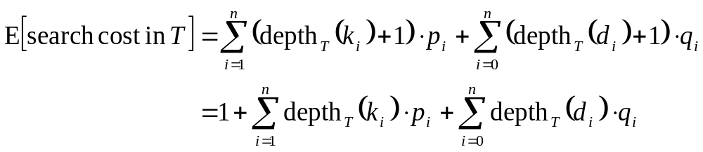
The expected cost
The sum of all the probabilities is
Assume: actual cost of search is 1 + the depth of the node.
The expected cost of a search in T is:

Slide 6
Node | Depth | Probability | Value
k₁ | 1 | .15 | .3
k₂ | 0 | .10 | .1
k₂ | 2 | .05 | .15
k₄ | 1 | .1 | .2
k₅ | 2 | .2 | .6
d₀ | 2 | .05 | .15
d₁ | 2 | .1 | .3
d₂ | 3 | .05 | .2
d₃ | 3 | .05 | .2
d₄ | 3 | .05 | .2
d₅ | 3 | .1 | .4
Total |  |  | 2.8
The expected
cost of a
search in
the binary
search tree
on the slide
is:
2.8

Slide 7
Step 1: The structure of an optimal binary search tree
Consider any subtree of a binary search tree.
  It must contain keys in a contiguous range k_{i}, … , k_{j}.
  It must also have as its leaves the dummy keys d_{i-1}, … , d_{j}.

Slide 8
Optimal substructure
If an optimal binary search tree T has a subtree T’ containing keys k_{i}, … , k_{j}, then T’ must be optimal for the subproblem with keys k_{i}, … , k_{j} and dummy keys d_{i-1}, … , d_{j}.
Proof
If there were a subtree T’’ containing keys k_{i}, … , k_{j,} whose expected cost is lower than that of T’, then we could cut T’ out of T and paste in T’’, resulting in a binary search tree of lower expected cost than T

Slide 9
The structure of the optimal solution
Given keys k_{i}, … , k_{j}, one of these keys k_{r} will be the root of an optimal subtree containing these keys.
The left subtree of the root k_{r} will contain the keys k_{i}, … , k_{r-1} (and dummy keys d_{i-1}, … , d_{r-1})
The right subtree will contain keys k_{r+1}, … , k_{j} (and dummy keys d_{r}, … , d_{j}).

Slide 10
Step 2: A recursive solution
Define e[i, j] as the expected cost of searching an optimal binary search tree containing the keys k_{i}, … , k_{j}.
Goal: Compute e[1, n].
e[1..n+1, 0..n] is a matrix with (n+1) rows and columns
Case 1: j = i –1 for i = 1, …, n+1
Tree has only dummy key d_{i-1}.
e[i, i – 1] = q_{i –1}.

Slide 11
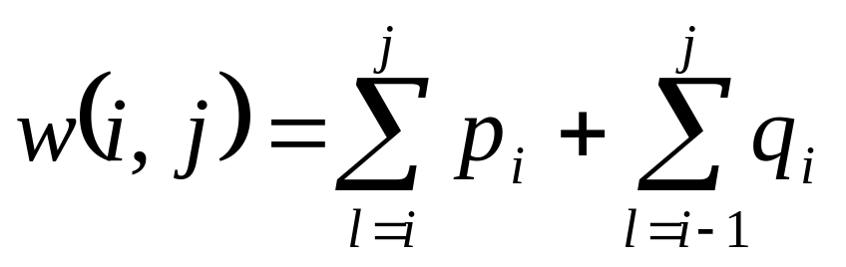
Step 2: A recursive solution
Case 2: j>=i.
Tree has a root and two subtrees
When a tree becomes a subtree of a node, the depth of each node in the subtree increases by 1.
For a subtree with keys k_{i}, … , k_{j}, we denote the sum of probabilities as

Slide 12
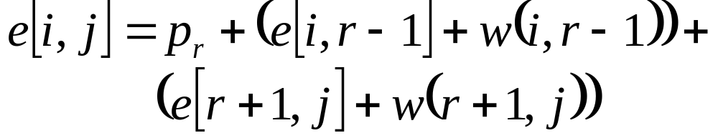
Step 2: A recursive solution
If k_{r} is the root of an optimal subtree containing keys k_{i}, …, k_{j}, we have
Note:
Rewrite e[i, j] as:.

Slide 13
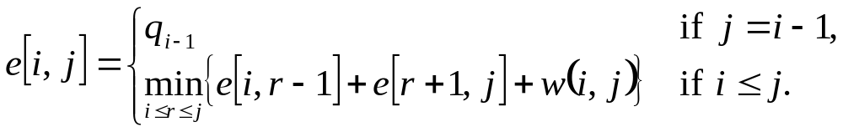
The recurrence equation

Slide 14
Matrices used by the dynamic programming solution
e[1..n+1, 0..n]
  e[i, j] = expected search cost in optimal binary search trees.
root[1..n+1, 0..n]
  root[i, j] = the index r for which k_{r} is the root of an optimal binary search tree containing keys k_{i}, … , k_{j}.
w[1..n+1, 0..n]

Slide 15
Optimal-BST(p, q, n)
Optimal-BST (p, q, n)
for i <- 1 to n + 1 //left to main diagonal
e[i, i-1] <- q_{i-1}
w[i, i-1] <- q_{i-1}
for diagonal<- 1 to n
for i <- 1 to n - diagonal +1
j <- i + diagonal –1
w[i, j] = w[i, j-1] + p_{j} + q_{j}
e[i, j] = …
root[i, j] = r that gave minimum
return e and root

